Slide 1
Introduction to Computing

Slide 2
Objectives
To learn and appreciate the following concepts
Problem solving basics
Logic and its importance in problem solving
Various computational problems and its classification
Computer Organization and operating system
Different types of languages
History of C, Typical C program development environment.

Slide 3
Session outcome
At the end of session the student will be able to understand
Importance of problem solving techniques, Computer organization, Operating system, Types of languages
History of C, programming development environment

Slide 4
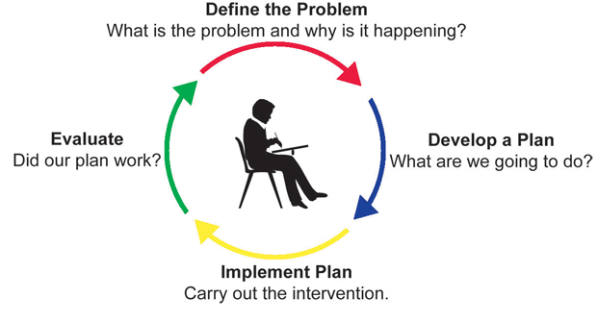
Introduction to problem solving
Notes:
Additional notes on problem solving
A problem exists when there is a situation you want to resolve but no solution is readily apparent. Problem solving is the process by which the unfamiliar situation is resolved. A situation that is a problem to one person may not be a problem to someone else.

Slide 5
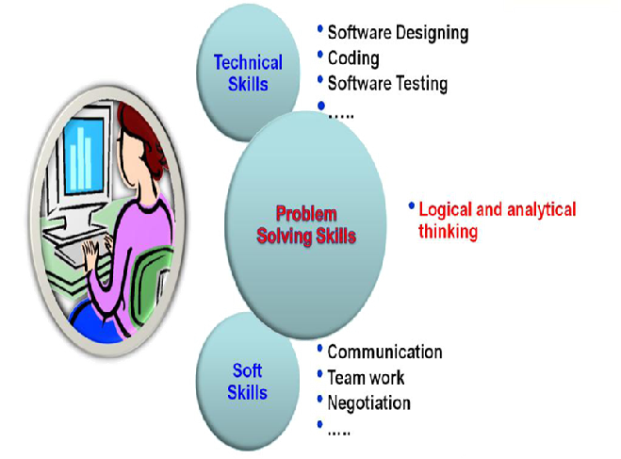
Skill set required for Software Engineers
Notes:
Additional notes on problem solving skills
Problem solving Skill is the key skill required for a software engineer as it helps to develop technical as well as soft skills.
Logical Thinking
Thinking in terms of cause and consequences
Sequential thinking
Means following a train of thought
Helps in decision making and problem solving

Slide 6
What is a problem?
A problem is a puzzle that requires logical thought or mathematics to solve
A puzzle could be a set of questions on a scenario which consists of description of reality and a set of constraints about the scenario
Eg: Scenario- Infosys Mysore campus has a library. The librarian issues book only to Infosys employees.
Description of reality: There is a library in Infosys Mysore campus . There is a librarian in the library
Constraints: librarian issues book only to Infosys employees.
Questions about the scenario: How many books are there in the library? How many books can be issues to an employee?
Does the librarian issue book to himself? Etc.

Slide 7

Logic
A method of human thought that involves thinking in a linear, step by step manner about how a problem can be solved
Logic is a language for reasoning. It is a collection of rules we use when doing reasoning.
Eg: John’s mother has four children.
First child is April
Second child is May
Third child is June
What is the name of fourth child?

Slide 8
Importance of logic in problem solving
Solution for any problem(eg: summation of two numbers) requires three things.
Input: Input values(Eg: 3 and 2)
Process: Process of summation
Output: Output after process (Eg: sum of numbers,5)
The process part(Eg: summation) of the solution requires logic( How to sum) or in other words based on the logic, process is developed.

Slide 9
Importance of logic in problem solving
For solving a problem, there may be multiple valid logics, some may be simple and some may be complex.
Eg: To determine whether the number is prime or not.
Logic 1- divide the number by all the numbers starting from 2 to one less than the number and if for all the division operations, the reminder is non zero, the number is prime. Else the number is not prime.
Logic 2 – same as logic 1 but divide the number from 2 to number/2
Logic 3 - same as logic 1 but divide the number from 2 to square root of the number

Slide 10
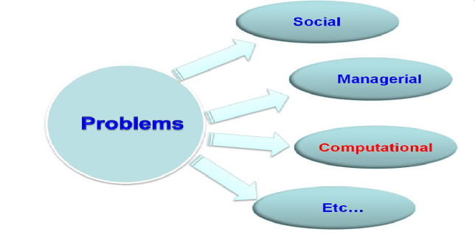
Types of problems

Slide 11

Computational Problems
Definition: Computation is a process of evolution from one state to another in accordance with some rules.

Slide 12
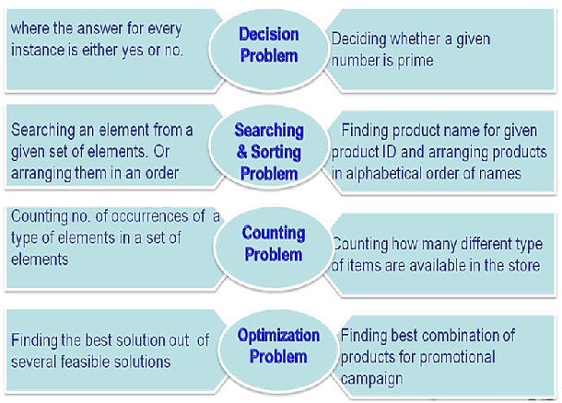
Broad applications of Computational Problem

Slide 13
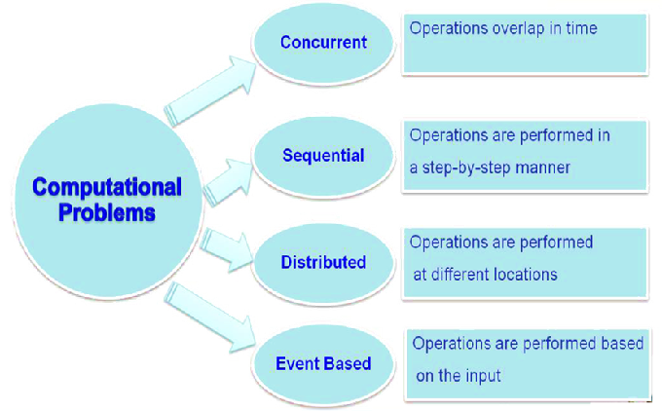
Classification of computational problems

Slide 14
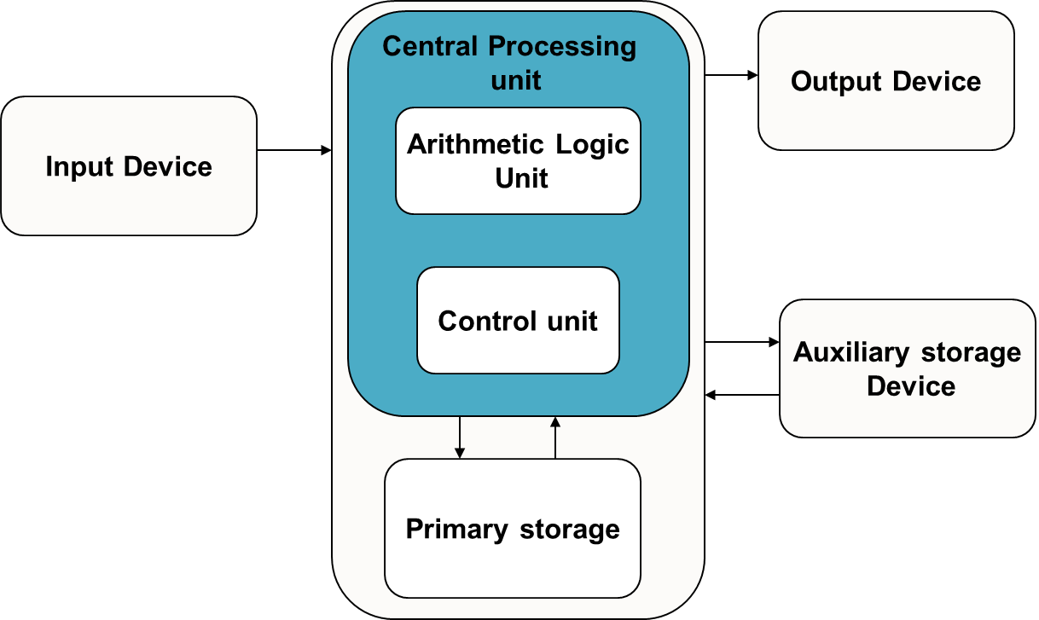
Computer Organization
Notes:
Additional notes on computing process information
A computer can process data, pictures, sound and graphics. They can solve highly complicated problems quickly and accurately. There are basically five major computer operations or functions irrespective of their size and make. They are
1) It accepts data or instructions by way of input,
2) It stores data,
3) It can process data as required by the user,
4) It gives results in the form of output, and
5) It controls all operations inside a computer.
Computer operations
1. Input: This is the process of entering data and programs in to the computer system. You should know that computer is an electronic machine like any other machine which takes as inputs raw data and performs some processing giving out processed data. Therefore, the input unit takes data from us to the computer in an organized manner for processing.
2. Storage: The process of saving data and instructions permanently is known as storage. Data has to be fed into the system before the actual processing starts. It is because the processing speed of Central Processing Unit (CPU) is so fast that the data has to be provided to CPU with the same speed. Therefore the data is first stored in the storage unit for faster access and processing. This storage unit or the primary storage of the computer system is designed to do the above functionality. It provides space for storing data and instructions.
The storage unit performs the following major functions:
• All data and instructions are stored here before and after processing.
• Intermediate results of processing are also stored here.
3. Processing: The task of performing operations like arithmetic and logical operations is called processing. The Central Processing Unit (CPU) takes data and instructions from the storage unit and makes all sorts of calculations based on the instructions given and the type of data provided. It is then sent back to the storage unit.
4. Output: This is the process of producing results from the data for getting useful information. Similarly the output produced by the computer after processing must also be kept somewhere inside the computer before being given to you in human readable form. Again the output is also stored inside the computer for further processing.
5. Control: The manner how instructions are executed and the above operations are performed. Controlling of all operations like input, processing and output are performed by control unit. It takes care of step by step processing of all operations inside the computer.

Slide 15
Central Processing Unit
Data and instructions are processed in CPU
Consists of two functional units
Control Unit (CU)
Arithmetic and Logic Unit (ALU)
Notes:
Additional notes on CPU
Central Processing Unit (CPU) or the processor is also often called the brain of computer. In addition, CPU also has a set of registers which are temporary storage areas for holding data, and instructions. ALU performs the arithmetic and logic operations on the data that is made available to it. CU is responsible for organizing the processing of data and instructions. CU controls and coordinates the activity of the other units of computer. CPU uses the registers to store the data, instructions during processing.

Slide 16
Arithmetic and Logical unit
Performs arithmetic and logical operations:
Example:
arithmetic(+,-,*,/ etc..) and
logical (AND, OR, NOT, <,= etc..) operations
Notes:
Additional notes on ALU
An eight bit instruction informs the ALU which operation it is to carry out. One number to be manipulated comes from the accumulator, the other from memory or another register. The result is stored in the accumulator. Flags in the status register are set to indicate the result, such as negative etc

Slide 17
Control unit
Controls the order in which your program instructions are executed.
Functions of CU:
Fetches data and instructions to main memory
Interprets these instructions
Controls the transfer of data and instructions to and from main memory
Controls input and output devices.
Overall supervision of computer system
Notes:
Additional notes on CU
A control unit is circuitry that directs operations within the computer's processor by directing the input and output of a computer system. The processor then controls how the rest of the computer operates (giving directions to the other parts and systems). A control unit works by gathering input through a series of commands it receives from instructions in a running programs and then outputs those commands into control signals that the computer and other hardware attached to the computer carry out.
The control unit is basically circuitry inside the CPU, controlling the operations inside the CPU and "directing traffic" in a sense. The functions a control unit performs can depend on the type of CPU, since the varying degrees of architecture between all the different CPUs will determine the functions of the control unit.

Slide 18
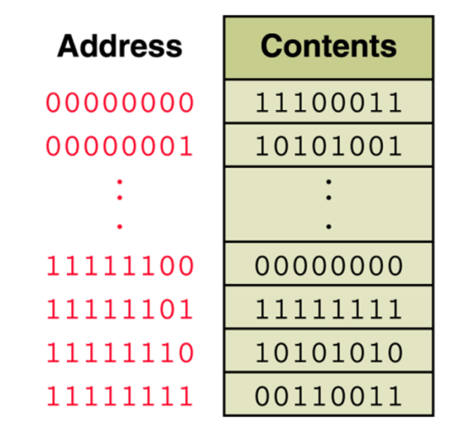
Memory unit
Storage device where the data and instructions fed by the user are stored
An ordered sequence of storage cells, each capable of holding a piece of information
Each cell has its own unique address
The information held can be input data, computed values, or your program instructions.
Notes:
Additional notes on memory
The computer starts using the memory from the moment the computer is switched on, till the time it is switched off. The list of steps that the computer performs from the time it is switched on are—
1. Turn the computer on.
2. The computer loads data from ROM. It makes sure that all the major components of the computer are functioning properly.
The computer loads the BIOS from ROM. The BIOS provides the most basic information about storage devices, boot sequence, security, plug and play capability and other items.
3. The computer loads the OS from the hard drive into the system’s RAM. CPU has immediate access to the OS as the critical parts of the OS are maintained in RAM as long as the computer is on. This enhances the performance and functionality of the overall system.
4. Now the system is ready for use.
5. When you load or open an application it is loaded in the RAM. Since the CPU looks for information in the RAM, any data and instructions that are required for processing (read, write or update) is brought into RAM. To conserve RAM usage, many applications load only the essential parts of the program initially and then load other pieces as needed. Any files that are opened for use in that application are also loaded into RAM.
6. The CPU requests the data it needs from RAM, processes it and writes new data back to RAM in a continuous cycle. The shuffling of data between the CPU and RAM happens millions of times every second.
7. When you save a file and close the application, the file is written to the secondary memory as specified by you. The application and any accompanying files usually get deleted from RAM to make space for new data.
8. If the files are not saved to a storage device before being closed, they are lost.
The memory unit is the part of the computer that holds data and instructions for processing. Although it is closely associated with the CPU, in actual fact it is separate from it. Memory associated with the CPU is also called primary storage, primary memory, main storage, internal storage and main memory. When we load software from a floppy disk, hard disk or CD-ROM, it is stored in the memory unit.

Slide 19
Memory unit
The computer memory is measured in terms of bits, bytes and words.
A bit is a binary digit either 0 or 1.
A byte is unit of memory and is defined as sequence of 8 bits.
The word can be defined as a sequence of 16/32/64 bits or 2/4/8 bytes respectively depending on the machine architecture
Notes:
Additional notes on memory units
The computer’s memory stores data, instructions required during the processing of data, and output results. Storage may be required for a limited period of time, instantly, or, for an extended period of time. Different types of memories, each having its own unique features, are available for use in a computer. The cache memory, registers, and RAM are fast memories and store the data and instructions temporarily during the processing of data and instructions. The secondary memories like magnetic disks and optical disks have large storage capacities and store the data and instructions permanently, but are slow memory devices. The memories are organized in the computer in a manner to achieve high levels of performance at the minimum cost.

Slide 20
Computer memory classifications
Main memory-Primary storage
Secondary memory-Auxiliary storage
Cache memory

Slide 21
Main memory
Memory where the data and instructions, currently being executed are stored
Located outside CPU
High speed
Data and instructions stored get erased when the power goes off
Also referred as primary / temporary memory
Semiconductor memory
Measured in terms of megabytes and gigabytes
Notes:
Additional notes associated with main memory
Primary memory is the main memory of computer.
It is a chip mounted on the motherboard of computer.
Primary memory is categorized into two main types- Random Access Memory (RAM), and Read Only Memory (ROM).

Slide 22
Primary storage: RAM & ROM
RAM stands for Random Access Memory
Read and write memory
Information typed by the user are stored in this memory
Any memory location can be accessed directly without scanning it sequentially (random access memory)
During power failure the information stored in it will be erased → volatile memory
ROM stands for Read Only Memory
Permanent memory and non volatile
Contents in locations in ROM can not be changed
Stores mainly stored program and basic input output system programs
Notes:
Nominal RAM size can be 8-12 GB
OS is stored in harddisk.

Slide 23
Secondary memory
Main memory is volatile and limited
Hence it is essential for other types of storage devices where programs and data can be stored when they are no longer being processed
Installed within the computer at the factory or added later as needed
Notes:
Additional notes on secondary storage devices
Secondary memory on a computer is storage for data and programs not in use at the moment. In addition to punched cards and paper tape, early computers also used magnetic tape for secondary storage. Tape is cheap, either on large reels or in small cassettes, but has the disadvantage that it must be read or written sequentially from one end to the other

Slide 24
Secondary memory
Non-volatile memory
Made up of magnetic material
Stores large amount of information for long time
Low speed
Holds programs not currently being executed
Notes:
Input, output, and auxiliary/secondary storage devices attached to a computer are called peripherals. E.g. Magnetic tapes, magnetic disks, compact disks etc.

Slide 25
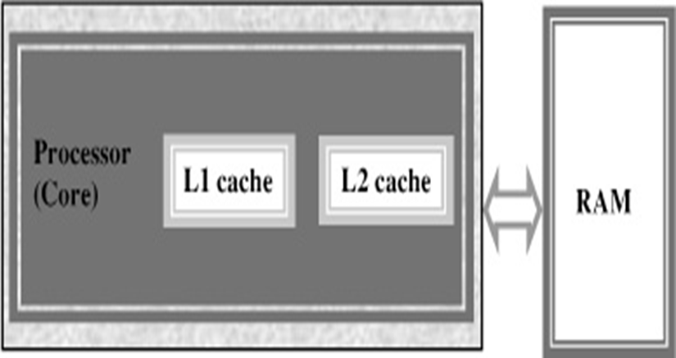
Cache memory
High speed memory placed between CPU and main memory
Stores data and instructions currently to be executed
More costlier but less capacity than main memory
Users can not access this memory
Notes:
Additional notes on cache memory
The data and instructions that are required during the processing of data are brought from the secondary storage devices and stored in the RAM. For processing, it is required that the data and instructions are accessed from the RAM and stored in the registers. The time taken to move the data between RAM and CPU registers is large. This affects the speed of processing of computer, and results in decreasing the performance of CPU.
Cache memory is a very high speed memory placed in between RAM and CPU. Cache memory increases the speed of processing.
Cache memory is a storage buffer that stores the data that is used more often, temporarily, and makes them available to CPU at a fast rate. During processing, CPU first checks cache for the required data. If data is not found in cache, then it looks in the RAM for data.
To access the cache memory, CPU does not have to use the motherboard’s system bus for data transfer. (The data transfer speed slows to the motherboard’s capability, when data is passed through system bus. CPU can process data at a much faster rate by avoiding the system bus.)
Cache memory is built into the processor, and may also be located next to it on a separate chip between the CPU and RAM. Cache built into the CPU is faster than separate cache, running at the speed of the microprocessor itself. However, separate cache is roughly twice as fast as RAM.
The CPU has a built-in Level 1 (L1) cache and Level 2 (L2) cache. In addition to the built-in L1 and L2 cache, some CPUs have a separate cache chip on the motherboard. This cache on the motherboard is called Level 3 (L3) cache. Nowadays, high-end processor comes with built-in L3 cache, like in Intel core i7. The L1, L2 and L3 cache store the most recently run instructions, the next ones and the possible ones, respectively. Typically, CPUs have cache size varying from 256KB (L1), 6 MB (L2), to 12MB (L3) cache.

Slide 26
Operating System
OS is an integrated collection of programs which make the computer operational and help in executing user programs.
It acts as an interface between the man and machine.
It manages the system resources like memory, processors, input-output devices and files.
Windows, Linux, DOS

Slide 27
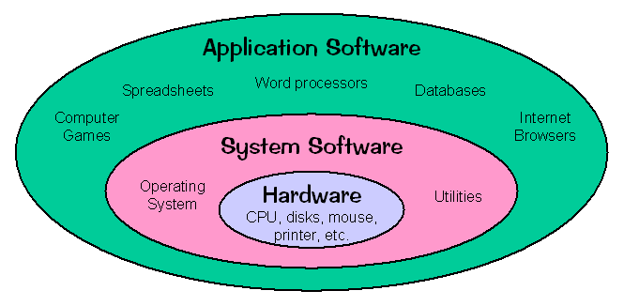
Application software, System software & Hardware
Notes:
Without CPU, you cant even think of a PC, and without OS, your PC is useless

Slide 28
Computer Languages
Machine Language- The only programming language available in earlier days
Consists of only 0’s and 1’s; e.g.:- 10101011
Symbolic language or Assembly language-
symbols or mnemonics are used to represent instructions
hardware specific
e.g. MASM : ADD X,Y; Add the contents of y to x
High-level languages- English like language using which the programmer can write programs to solve a problem.
more concerned with the problem specification
not oriented towards the details of computer
e.g.: C, C++, C#, Fortran, BASIC, Pascal etc.

Slide 29
Language Translator
Compiler : Program that translates entire high level language program into machine language at a time. e.g.:- C, C++ compilers.
Interpreter : Program which translates one statement of a high level language program into machine language at a time and executes it.
e.g.:- Basic Interpreters, Java Interpreters.
Assembler : Program which translates an assembly language program into machine language.
e.g.:- TASM(Turbo ASseMbler), MASM(Macro ASseMbler).

Slide 30
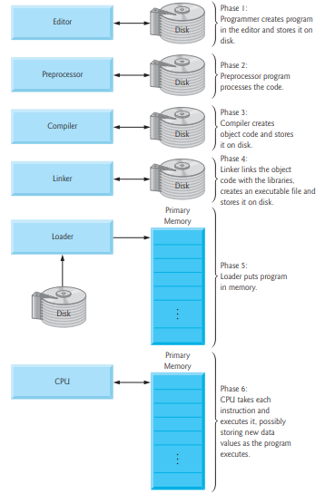
Typical C program development environment
Notes:
The C preprocessor is a macro processor that is used automatically by the C compiler to transform your program before actual compilation.
The C preprocessor provides four separate facilities that you can use as you see fit:
Inclusion of header files. These are files of declarations that can be substituted into your program.
Macro expansion. You can define macros, which are abbreviations for arbitrary fragments of C code, and then the C preprocessor will replace the macros with their definitions throughout the program.
Conditional compilation. Using special preprocessing directives, you can include or exclude parts of the program according to various conditions.
Line control. If you use a program to combine or rearrange source files into an intermediate file which is then compiled, you can use line control to inform the compiler of where each source line originally came from.
Object code is output of compiler. It can be in binary forms. Object codes linked together forms executable file to be executed.

Slide 31
Typical C program development environment
C programs typically go through six phases to be executed. These are: edit, preprocess, compile, link, load and execute
Phase 1 : creating a program
Phases 2 and 3: Preprocessing and Compiling a C Program
Phase 4: Linking
Phase 5: Loading
Phase 6: Execution
Notes:
Phase 1 : creating a program
Phase 1 consists of editing a file.
This is accomplished with an editor program
The editor Named CodeBlocks will be used for creating the program.
You type a C program with the editor, make corrections if necessary, then store the program on a secondary storage device such as a hard disk.
C program file names should end with the .c extension
Phases 2 and 3: Preprocessing and Compiling a C Program
In phase 2, you compile the program.
The compiler translates the C program into machine language-code (also referred to as object code).
In a C system, a preprocessor program executes automatically before the compiler’s translation phase begins.
The C preprocessor obeys special commands called preprocessor directives, which indicate that certain manipulations are to be performed on the program before compilation.
These manipulations usually consist of including other files in the file to be compiled and performing various text replacements.
The most common preprocessor directives are #include, #define etc.
In Phase 3, the compiler translates the C program into machine-language code.
Phase 4: Linking
C programs typically contain references to functions defined elsewhere, such as in the standard libraries or in the private libraries of groups of programmers working on a particular project.
The object code produced by the C compiler typically contains “holes” due to these missing parts.
A linker links the object code with the code for the missing functions to produce an executable image
Phase 5: Loading
Before a program can be executed, the program must first be placed in memory.
This is done by the loader, which takes the executable image from disk and transfers it to memory.
Additional components from shared libraries that support the program are also loaded.
Phase 6: Execution
Finally, the computer, under the control of its CPU, executes the program one instruction at a time.

Slide 32
Summary
Problem solving
Logic and its importance in problem solving
Computational problems and its classifications
Computer organization and operating system
Different computer languages
Typical C program development environment

